Slide 1
Resilience Systems Analysis
[insert place and dates]
[Insert a picture relevant to the context]
Notes:
Facilitator’s preparation :
Insert a picture relevant to the context
Put the slide on the screen while participants enter the room on Day 1

Slide 2
Introduction
[Insert a picture relevant to the context]
Notes:
Throughout the presentation, green boxes with red font indicate modifications or adaptation you need to do, to adapt the PowerPoint to the particular context of your workshop.
Insert pictures relevant to your context on the slides. Ensure the size of pictures is reduced to avoid designing a PowerPoint presentation which would slow computers down

Slide 3
Workshop Objectives
[Fine tune the objectives according to your specific context and scoping question]
By the end of the workshop participants will be able to:
• Describe concepts linked to resilience such as risks, shocks, stresses, vulnerabilities and capacities;
• Share a vision of current and future risks and their impact on the system;
• Develop a road map to boost the system’s resilience.
Notes:
Facilitator’s preparation :
You can fine tune the objectives according to your specific context and scoping question

Slide 4
Ground Rules/Principles of effective collaboration
Keep your mobile on silent
Close your laptop during all sessions
Be punctual, including after breaks
Participate and listen actively
Stay on the topic
Ensure there is one conversation at a time
Respect each other
Any additional points ?
Notes:
Ask participants to stick additional ideas on the flipchart “Additional Expectations” on the wall

Slide 5
Workshop Agenda
[Paste a picture of your workshop agenda here]
Notes:
Facilitator’s preparation :
After designing your agenda in word, copy and click on paste special/ Select in the Menu Picture PNG
Ask participants to refer to their own copy of the agenda (on a handout) while you walk them through it

Slide 6
Workshop’s scoping question
 | Explanation | For the workshop
Resilience of what system ? | Resilience of a system, or a component of a system | E.g. Livelihoods systems
Resilience to what risk/s ? | Focus on specific risks or shocks from the risk landscape | E.g. Natural, geopolitic, economic risks (idiosyncratic and covariable)
Resilience for whom? | Groups of individuals or for a specified geographical location | E.g. Host families, IDPs and returnees in Eastern DRCongo
Resilience over what timeframe ? | Timeframe considered for the analysis, depending on programming cycle | E.g. Over the next three years
[Modify this column to include elements from your scoping question]
Notes:
Facilitator’s preparation : The last column provides you with an example from Eastern DRC. After reviewing it, delete its content and replace with
key points from your scoping question.
Explain the 4 axis defining the boundaries of the resilience systems analysis

Slide 7
Modules
1
2
3
4
5
Risks, stresses and their impact on systems
Analysis of characteristics of the system’s components
Analysis of stakeholders and processes influencing the system
Identifying gaps in the system’s resilience
Developing a roadmap to strengthen resilience
Past, Present, Future
Estimation of negative and positive impacts of each shocks on each system component
Past, Present, Future
Past, Present, Future
Present
Future
Exercices
Definition of analysis scoping question
Review of stakeholders processes, size and influence related to access to system components
Discussion on the ability of system components to resist the expected combined impacts of the external context + the internal pressure
Identification of risk adverse and risk taking actors
Analysis of causes and effects linking covariate, idiosyncretic, seasonal, cyclical risks, low impact and high frequency events with stressors
Prioritizing and sequencing possible actions to support the three types of capacities for each system component
Analysis of components vulnerability and capacity and change linked with internal pressure
Identification of current actions by external actors to support existing strategies when facing shocks
Brainstorming on measures to boost resilience
Listing of system components
Listing of livelihoods assets per capital group
Exploring how to measure impact of the actions aiming at strengthening resilience
Ranking of system component from the least to the most affected
Analysis of main risks’ severity
Products
Graphical representation of causes and effect linking risks with stressors
Two lists of system components : the most and the least affected by chocks.
List of stakeholders and processes per society level
Comparison between local lessons learnt and external best practice to reinforce pathways of weaknesses and support pathways of strengths
Roadmap with short, medium and long term actions to strengthen resilience.
Stakeholder map.
Current and future risk heatmaps
Identification of interdependency between system’s components
Identification of key stakeholders and processes to be engaged with
List of current actions by external stakeholders for each system component classified per capacity .
Analysis sheet per risk
Mapping of existing databases and gaps
Identification of existing absorption, adaptation, transformation strategies
List of measures to exploit to exploit opportunities, to change systems in perpetual negative state and to add capacities and reduce vulnerabilities.
List of potential opportunities triggered by specific risks

Slide 8
How to ensure we reach the workshop’s objectives
Active and balanced participation
Daily evaluation and daily review
Suggestion Box
Final evaluation
Participant Action Plans
Notes:
Explain that participants will do a brief evaluation at the end of day 1, and a final evaluation on day 2.
They are encouraged to use the Suggestion Box at the back of the room, at an time.
To ensure that the workshop will have a real impact on participants’ daily work, they will have to develop an Action Plan at the end of the workshop, in which they will individually commit to three key actions.

Slide 9
Security and Logistics
[Add a few key points]
x
Notes:
Facilitator’s preparation :
Add a few key points relevant to particular context

Slide 10
INTRODUCTORY module:
What is resilience?
[Insert a picture relevant to the context]
Notes:
Facilitator’s preparation :
Insert a picture relevant to the context

Slide 11
Module Aim
To provide an overview of definitions and concepts to deepen understanding of resilience
[Insert a picture relevant to the context]
Notes:
Facilitator’s preparation :
Insert a picture relevant to the context

Slide 12
Module Objectives
• List key words to define idiosyncratic and covariate shocks, risks and stresses and resilience
• Explain the three types of capacities which contribute to strengthening resilience.
Describe the added value of resilience, compared to Risk Reduction approaches
Notes:
Ask one participant to read the first objective, another participant will read the second one etc.. You can use the same approach throughout the workshop

Slide 13
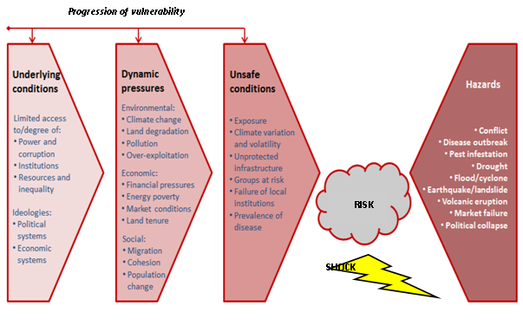
What is risk?
Notes:
Distribute this slide as a handout. Ask participants if they have already seen the figure and for their reactions and comments. Complement their input.

Slide 14
Terminology: Risks, Shocks and Stresses
Past
Future
Shocks
Crisis
Disasters
Risks
Seasonal shocks/ risks
Recurring shocks/ risks
Stresses
Idiosyncratic: impacting only on specific elements of a system
Covariate : impacting on systems on a large scale
Stress: A long-term trend driving shocks and risks
Notes:
Explain that the term “Risks” is used to refer to the future.
When risks have actually happened, they are called shocks, crises or disasters.
Covariable shocks - widespread infrequent events such as violent conflict, volcanic eruptions or the sudden introduction of new technology, e.g. cell phones.
Idiosyncratic shocks - significant events that specifically affect individuals and families, such as the death of the main breadwinner or loss of income generating activity.
Seasonality impacts - such as annual flooding, linked to the rainy season and market price changes
Recurring shocks - small but frequent events, such as bouts of diarrhoea in communities, or frequent short-term, short distance displacement due to conflict.
Stresses - long-term, often interconnected trends that drive these events (e.g. Climate Change)

Slide 15
Different Definitions: What is Resilience?
OECD definition
Resilience is the ability of households, communities and states – layers of society – to absorb and recover from shocks, whilst positively adapting and transforming their structures and means for living in the face of long-term, changing and uncertain impacts of stresses
XXX
definition
x
[Include the definition of the host of the workshop or a participating agency]
Notes:
Facilitator’s preparation :
Include the definition of resilience of the host of the workshop, or the participating agency/ agencies, or the country you are working in
Explain that the next two slides present some definitions, but that we are not here to debate the semantics of words used.
The importance is for participants to remember key words that relate to “Resilience”
Ask participants to read the handout and highlight key words of particular significance to them

Slide 16
What is Resilience?
Disaster Resilience is the ability of countries, communities and households to manage change, by maintaining or transforming living standards in the face of shocks or stresses - such as earthquakes, drought or violent conflict – without compromising their long-term prospects
DFID definition
IGAD definition
Resilience is the capacity to manage, adapt to, cope with or recover from stresses, shocks and disasters.
Resilience is the ability of people, households, communities, countries, and systems to mitigate, adapt to and recover from shocks and stresses in a manner that reduces chronic vulnerability and facilitates inclusive growth.
USAID definition

Slide 17



Three Capacities to boost Resilience
Intensity of change / transaction costs
Stability
Flexibility
Change
Adaptive capacity
Transformative capacity
Absorbtive/ coping capacity
Notes:
There are three forms of resilience boosting capacities :
Absorptive capacity: This is the capacity of a boxer to take a hit. The ability of a system to prepare for, mitigate or prevent the impacts of negative events using predetermined coping responses in order to preserve and restore essential basic structures and functions. This also includes coping mechanisms used duFring periods of shock.
Adaptive capacity: This is the capacity of a boxer to add new strategies to better manage hits coming from new directions. The ability of a system to adjust, modify or change its characteristics and actions to moderate potential, future damage and to take advantage of opportunities, all in order to continue functioning without major qualitative changes in function or structural identity.
Transformative capacity: This is the capacity of a boxer to make significant changes in his weight, his strategies and his boxing style in order to take on big hits coming from different directions. The ability to create a fundamentally new system when ecological, economic or social structures make the existing system untenable.
Implications moving from absorptive to transformative capacity:
While absorptive capacities focusing on stabilising a system in its current state, transformative capacity looks at changing it, which often means a different timeframe (it can start at the same time, but it takes longer to achieve impact and system change).
While supporting absorptive capacity is not a political issue, transforming systems often encounter political resistance. Transformation needs greater investment and longer term commitment.
Often the three capacities can be used at the same time:
For example, a coastal community in Bangladesh may use its absorptive capacity to protect their resources against annual flooding given their traditional skills in managing these; use adaptive skills to alter how they cultivate crops and collect drinking water that counters progressive salinity impacts due to sea level rises associated with climate change, and; transform the way they manage income through changing basic attitudes on the role and partnership of different community groups, and the role of women, in natural-resource exploitation.

Slide 18







Picturing what Resilience Systems Analysis is about
Notes:
Let us use an image to understand what Resilience System Analysis is actually about. A system is like a rock; weak in some places, but resistant in other places. Various large scale shocks (represented by hammers) and smaller scale or repetitive events (represented by acid) preferentially fracture and eat away the rock along the same system of cracks. These cracks represent weaknesses and vulnerabilities of the system, i.e. sites of relatively high risk for the future . Other untouched and resistant areas of the rock between the cracks are stronger and more resilient components of the system.
Resilient Systems Analysis focuses on the rock’s characteristics. What makes it strong in some components while it fractures and fails in other components? What can we learn from the strengths in the system, to reinforce weak components and build the resilience of the system as a whole to a range of shocks from natural phenomena, economic and geopolitical factors?

Slide 19
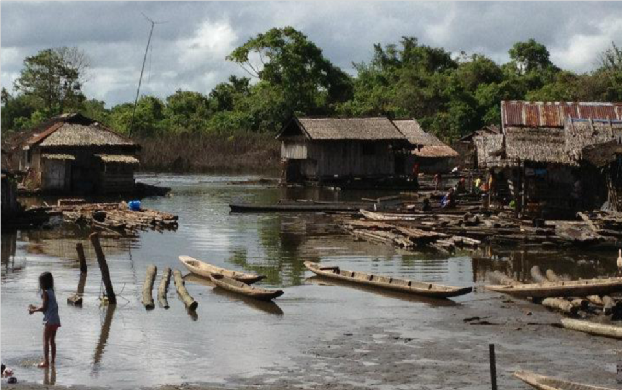
How can we actually boost resilience?
An example from Mindanao island, Phillipines
Notes:
This program in the Phillipines illustrates the conceptual framework just presented.
Led by the German Cooperation, the program was not specifically a “resilience bossting” program, but was planned as an integrated peace-building and poverty reduction strategy.

Slide 20
A Complex Operating Context
• A complex risks panorama including natural and geopolitical risks
A complex conflict combining land issues with multiple rebellions
Marginalised minorities
Variety of ecosystems with intense exploitation of resources
Widespread poverty
Political and economic power in the hands of a few
Lack of harmonised legislation.
Notes:
This slide highlights key features of the context, which are similar to many complex contexts which development and humanitarian actors operate in.

Slide 21
Key Success Factor: A technical approach supporting the three types of capacities
Absorptive Capacity | Adaptive Capacity | Transformative Capacity
Mitigation approaches to face both natural and geopolitical risks Support to human security Support to household livelihoods Strengthening local involvement in the management of natural parks affected by conflicts. | Support to the sustainable management of land and natural resources. Improvement of biodiversity | Local conflict transformation Legal support Local peace building Harmonisation of land use policies Strengthening of legislation and application of law. .
Notes:
We classified various components of the program according to the three types of capacities presented earlier.
Not only did component the program aim to reinforce absorptive capacity at different levels of the nation, but other programmatic aspects reinforced adaptive and transformative capacity.

Slide 22
Key Success Factor: Various actors combining their efforts at different levels of society
Absorptive Capacity | Adaptive Capacity | Transformative Capacity
Actor 1 Actor 3 | Actor 1 Actor 2 Actor 3 | Actor 2 .
Actor 3 | Actor 1 Actor 3 | Actor 2 Actor 5
Actor 6 | Actor 5 | Actor 5
National Level
RegionalLevel
Local
Level
Notes:
This table shows how the program was able to reinforce resilience, because it acted in a connected manner at various levels of society. Actions at a higher level, for instance, would not compromise the well-being of vulnerable individuals.
Such an approach enables the management of competing interests: indigenous, women, environment, government, companies etc.

Slide 23
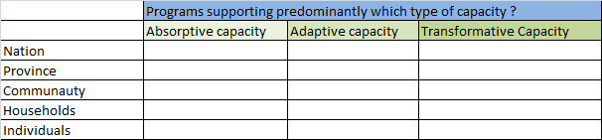
Strengthening Capacities at Different Levels of Society
Exercise 1
Per table | Duration
The matrix on the wall is similar to the one we have just seen completed for the Mindanao program. Write down with a marker pen one program per sticky note, and the name of the actor in charge. It can be any program you are aware of, not only one you work with. Stick each note onto the matrix, depending on the type of capacity the project aim to reinforce, and the level of society it operates at. | 20 mins.
Notes:
Facilitator’s preparation:
You will have drawn the above matrix by joining together 4 flipcharts in landscape format. The empty matrix should be stuck on the wall, so that all participants can see where they have to put their sticky notes.
Explain that we have seen the importance of various actors combining their efforts at different levels of society. We will now explore how far this is also the case for the workshop’s context.
Leave the instructions on the screen during the whole exercise, so that participants can easily refer to them. Do this throughout the workshop.
Debrief in plenary by looking at the filled table and pattern on the wall. Are most sticky notes concentrated at one level of society? In support of one capacity or more?

Slide 24
Definitions!
Exercise 2
Per table | Duration
Open your envelope and match each definition with the corresponding term. Stick it on a flip chart | 10 mins.
Notes:
Facilitator’s preparation :
You will have printed out 2 handouts of “Definitions" per table.
One of each remains as an A4 sheet, and will be distributed to the group later to assess whether they managed the exercise properly.
The other copy will have previously been cut into pieces and each term separated from its definition
Put all the cut out papers into one envelope and write the group’s number on it.
Distribute one envelope to each group, along with an empty flip chart and glue stick.
When all groups have finished gluing the pieces of paper onto the flipchart, give them the A4 sheets with the correct definitions. Let them correct themselves.

Slide 25
Review of Module Objectives
• List key words to define idiosyncratic and covariate shocks, risk and stresses.
• Describe the added value of Resilience compared to Risk Reduction approaches.
• Explain the three types of capacities which contribute to boosting resilience.
Notes:
Ask the first point to one participant and let him/ her answer
Do the same with each objective.
This is valid throughout the workshop, to check whether each module’s objective has been reached.
Clarify if answers provided are incorrect, or ask someone else in the room to provide an answer.

Slide 26
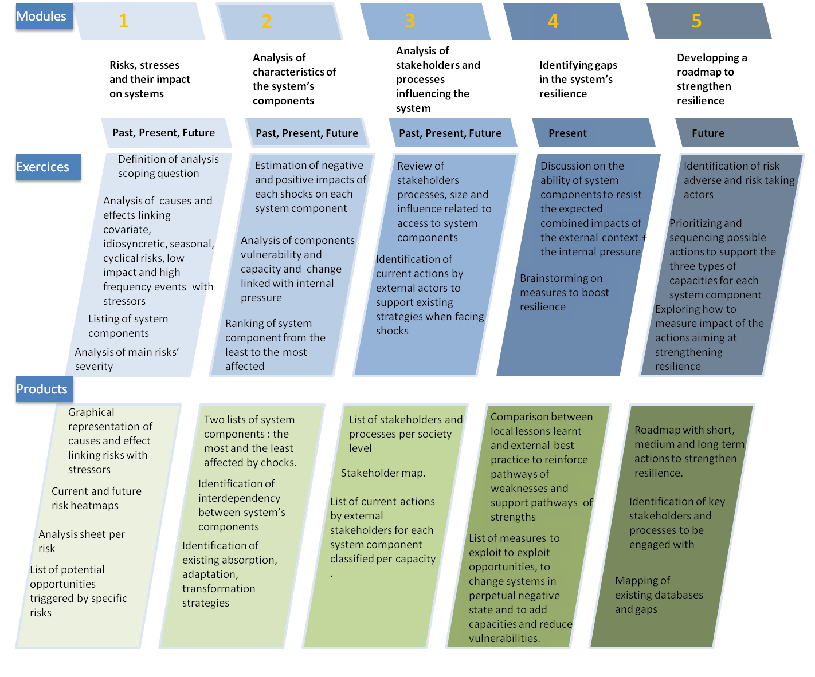
Module 1 risks, stresses and their impact on systems
[Insert a picture relevant to the context]
Notes:
Facilitator’s preparation :
Insert a picture relevant to the context

Slide 27
Module Aim
Share a vision of covariate, idiosyncratic and low-impact recurring shocks, as well as stresses and their long-term role fuelling change and uncertainty for the system under analysis
[Insert a picture relevant to the context]
Notes:
Facilitator’s preparation :
Insert a picture relevant to the context

Slide 28
Objectives
• Identify the key events and stresses that have impacted on and will impact on the system
• Describe the cause and effect relationships between these shocks and stresses
• Plot the likelihood and impact of shocks, to prioritise the most severe ones both now and within the agreed timeframe.

Slide 29
What external events trigger change in the system under analysis?
What key shocks and stresses have caused significant changes in the system?
Are there low-impact but high frequency events that have an important cumulative effect on the system?
Are there seasonal or cyclical events that have an important effect on the system?
What are the characteristics of the most important shocks affecting the system (nature, intensity, duration, frequency, impact, trigger)?
Notes:
Explain to participants that these questions underpinned the preparation of the briefing dossier outputs such as the risk fiches, the causes and effects panorama and the risk heatmap. They will have to keep these questions in mind during this module’s exercise

Slide 30
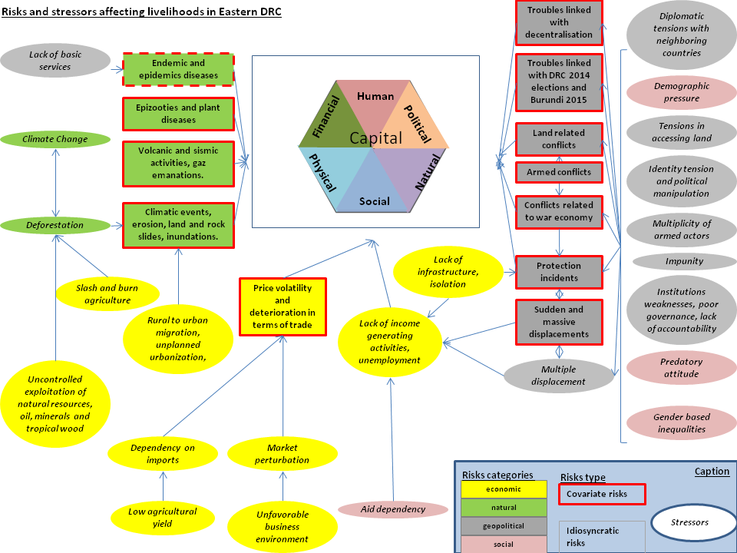
Analysing Causes and Effects between Shocks
[Replace with a picture of the cause and effect map you came up with for the Briefing Dossier]
Notes:
Facilitator’s preparation :
Replace this visual with the one you prepared for the Briefing Dossier.
You can prepare it in PowerPoint, then save the slide as a PNG picture and paste it on the slide.
You can also select all the elements on your slide, and click on paste/ paste special/ Picture (PNG)

Slide 31
Causes and Effects between Shocks
Exercise 3
Per table | Duration
Discuss the causes and effects of shocks and stresses impacting on the system under analysis. Add your comments/ additions/ modifications to the main page | 30 mins.
[Replace with a picture of the causes and effects map you came up with for the Briefing Dossier]
Notes:
Facilitator’s preparation :
Ensure you have 6 color print outs in A2 format and 1 color A4 handout per participant.
Distribute the A2 handout to each group, and the A4 to each participant. Ask groups to discuss and modify.
Participants might want to add some risks, or to change causal relations or categories ( e.g. considering some risks as stressors, or changing risks from covariate to idiosyncratic etc.)
At the end of the exercise, collect all sheets and explain you will produce a synthesis of all group visuals and include it in the report as a key output from the workshop.

Slide 32
How can we estimate each risk’s severity ?
Severity = likelihood * impact
The likelihood of a risk becoming a shock can be estimated based on existing contingency plans and scenarios, and research forecasting.
The impact of each risk on each part of the system can be ranked based on qualitative or quantitative data if available.

Slide 33
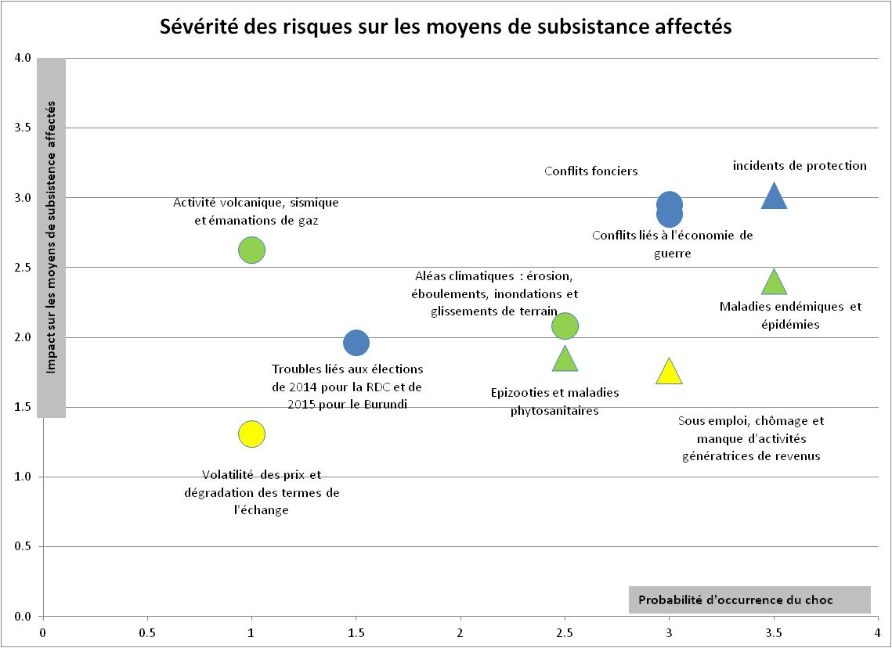
Drawing a Risk Heatmap
[Replace with a picture of the risks heatmap you came up with for the Briefing Dossier]
Notes:
Facilitator’s preparation :
Replace with a picture of the risks heatmap you came up with for the Briefing Dossier

Slide 34

Review of Risk Heatmap
Exercise 4
Group per table | Duration
For each point or triangle representing a risk: Discuss if you agree on its position (you can refer to the Briefing Dossier’s risks sheets). Draw a black arrow towards the area where the risk should be positioned now Draw a red arrow towards the area where the risk will be positioned in the future, within the timeframe of the analysis | 20 mins.
Notes:
Facilitator’s preparation :
Ensure you have 6 color print outs of the Heatmap in A2 format and 1 color A4 handout per participant.
Distribute the A2 handout per group, and the A4 to each participant. Ask groups to discuss and modify.
At the end of the exercise, collect all sheets and explain that you will produce a synthesis of all group work and include it in the report as a key output from the workshop .

Slide 35
Review of Module Objectives
• Identify the key events and stresses that have impacted on and will impact on the system under analysis
• Describe the cause and effect relationships between these shocks and stresses
• Plot the likelihood and impact of shocks, to prioritise the most severe ones both now and within the selected timeframe

Slide 36
module 2 analysis of characteristics of the system’s components
[Insert a picture relevant to the context]

Slide 37
Module Aim
Explain how different risks affect the various components of the system differently, depending on capacities and vulnerabilities, and on cascading impacts or new opportunities triggered by shocks
[Insert a picture relevant to the context]

Slide 38
Module Objectives
• Explain why some components are less affected and some more affected by shocks
• Identify key variables in terms of vulnerabilities and existing capacities, that explain the impact of the risk landscape on the system
• Identify links between key system components which accelerate vulnerabilities or capacities
List existing capacities of priority components

Slide 39
What is the Sustainable Livelihoods Approach?
Notes:
Ask participants if they know this figure and let them explain it to each other.
Refer to the Guidelines Section Conceptual Framework to add content if required.

Slide 40
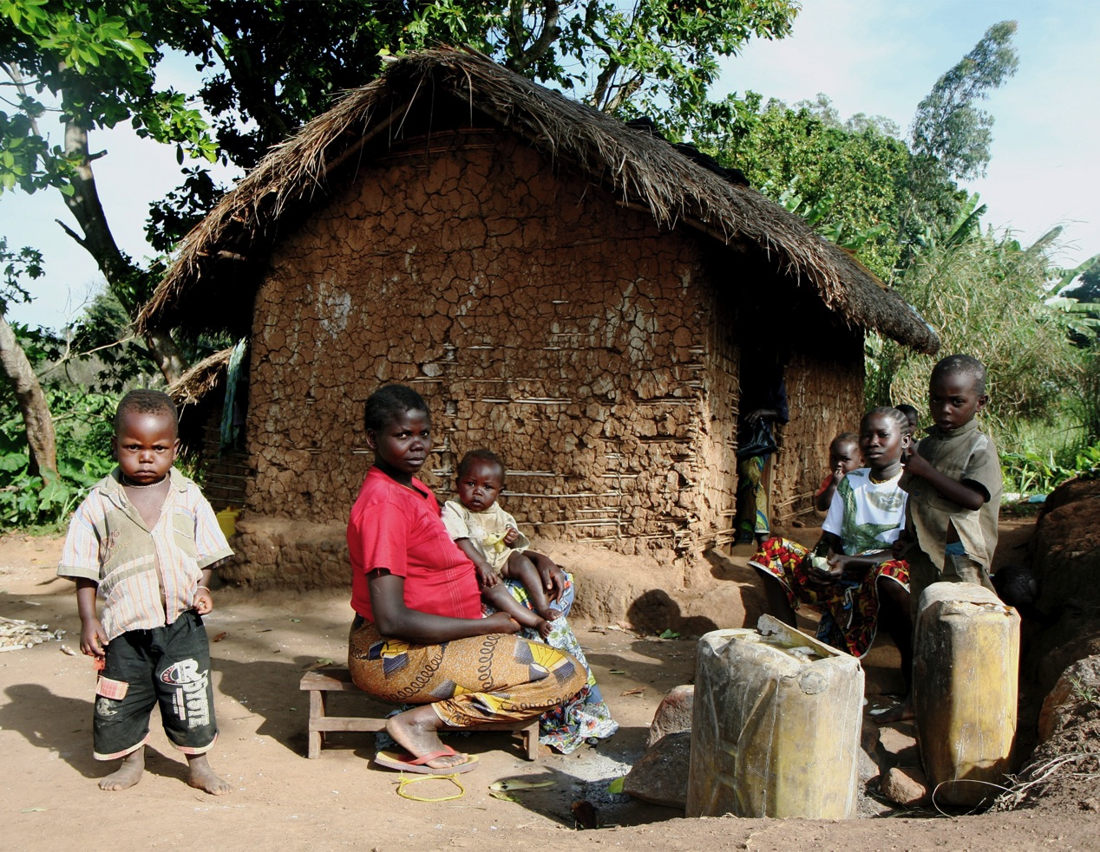
Notes:
Ask participants to describe elements of the Sustainable Livelihoods Framework that they can see in this picture , taken on the outskirts of Bunia, Eastern Democratic Republic of Congo
Prompt them on
Risk context
Capital groups
Institutions and processes
Strategies
Outcomes

Slide 41
Examples of Assets per Capital Group
Education
Vocational training
Health
Knowledge of essential practices
Income to cover basic needs
Additional production for sale
Formal employment
Informal employment
Savings
Gifts / Donations
Banks
Transfer of funds
Credit/ savings group
Participation in community meetings
Participation in community organizations influencing local power
Participation in democratic processes (elections, decentralization)
Membership in political parties
Access to those in authority
Knowledge of rights and duties
Human
Financial
Political
National Structure
Shelter
Access to Commodities
Access to Drinking Water
Access to Essential Household items
Access to Productive Land/ Productive capital ( Means of Transportation, Livestock etc.)
Access to Social Infrastructure
Sanitation
Energy
Physical
Natural
Social
Source of drinking water
Land for agriculture / livestock
Forest
Livestock
minerals
Biodiversity of the environment
Rivers and waterholes
Formal/Informal Conflict management mechanisms
Links & Social Networks supporting IDPs
Measures to protect girls and boys
Participation of women in social life
Community Committees
Notes:
Distribute a print out of this slide as a handout. This list of assets per capital group came out of the Eastern Democratic Republic of Congo workshop.
Ask participants to delete or add ideas relevant to the workshop’s context.

Slide 42
Key Questions Underpinning this Module
What have been the impacts of shocks and stresses on specific components of the system in the past?
Which components performed poorly? Which components continued to perform well? Why?
Which components benefited from opportunities that arose with the shock?
Which components suffered from cascading impacts, and interdependency with other components of the system?
Which components experienced change not linked with a shock, but with the cumulative effect of small events?
Do you foresee that any of the components’ characteristics will change in the future ?
Notes:
Facilitator’s preparation :
Print out 1 copy of these slide per group x 6 groups

Slide 43
Characteristics of System Components
Exercise 5
Group work | Duration
Select the group you are most interested in. Complement the list of components, adding ones relevant to the workshop’s context For each component you are working on : Discuss answers to the key questions listed on the handout. Write on a sticky note key points coming from your discussion. Stick the note on the matrix | 10 mins. 60 mins.
Notes:
Facilitator’s preparation :
For each of the 6 groups, prepare a matrix following the example provided on the next slide.
Stick together 4 flipcharts.
Draw 7 lines so each group is able to write down 7 different assets per capital group, or 7 structures if they work at national level. Draw the 3 columns.
During the lunch break, put the 6 matrices on the walls of the main room and the break out rooms.
Participants should not write directly on the flipchart because permanent markers might damage the wall. Write on post-it notes and stick these on the chart on the wall, in the appropriate matrix cell.
Ensure the post-its stick, or provide transparent tape to secure them on the flipchart. Ask participants to avoid using acronyms because as facilitator you need to understand everything written on the post-its. You will have to capture the content of all matrices in the evening.
Subsystems are livelihoods assets (as listed earlier under each capital group),
Participants can add some livelihoods assets in the different capitals
After having contributed to one group, participants can move to another group if they wish.
Debriefing in plenary:
Each group comes to the front to present its flipchart of key points, line by line. This is the only time such detailed feedback will be presented like this during the workshop, and it enables participants to get an overview of all components of the system under analysis.
.

Slide 44
An example before starting the exercise: Financial Capital
List of Financial Assets | Risks specifically affecting this Asset | Characteristics of this Asset
Income | Unemployment, price volatility | Impact of shocks: Loss of income, increased poverty level Poor performance of this asset in the face of shocks and stresses: income is directly affected by most shocks. Some opportunities to generate income are linked to illegal mining, created by the conflict. Income is suffering from its interdependency with other system components such as infrastructure. Income is suffering from internal pressure leading to a tipping point and recurrent losses of income often lead to destitution
Savings group | … | …
Notes:
Read the example and explain that this illustrates just one item. The groups have to discuss all items relevant to their capital group.
Observe the groups and tell them to prioritise the most important system component if discussion is taking too long and you can see that a group will not be able to reach a conclusion in the time available.

Slide 45
Selection of System Components to be Further Analysed
Exercise 6
Group work | Duration
In your groups select : The 2 system components that are reacting worst to shocks The 1 system component that is reacting best to shocks Report them in the first column of the large matrix on the wall | 15 mins.
Notes:
Facilitator’s preparation:
For each of the 6 groups, you have to prepare a large matrix
Stick together 4 flipcharts in portrait (lengthwise), side by side along their long edges.
Flipchart Titles:
Flip chart 1: Asset/ Structure
Flip chart 2 Column 1: Risks specifically affecting this asset
Flip chart 2 Column 2: Characteristics of this asset
Flip chart 3 Column 1: Existing absorptive capacity
Flip chart 3 Column 2: Existing adaptive capacity
Flipchart 3 Column 3: Existing transformative capacity
Flip chart 4 Column 1: Additional absorptive capacity
Flip chart 4 Column 2: Additional adaptive capacity
Flipchart 4 Column 3: Additional transformative capacity
Draw 3 lines across the flip charts, 1 for each item that Exercise 6 will prioritise.
Groups need to stick their matrix on the wall
When Exercise 6 is over, groups report the name of the 3 items they selected in each line of the new matrix.
They then stick the relevant sticky notes in the appropriate cells, in order to capture the findings from Exercise 5 on the new matrix, for the selected items only.
Explain that Resilience System Analysis is focusing on learning from the characteristics of component of the system functioning the best or the worst in face of shocks, and using the lessons derived to apply them to other component of the systems.
We therefore have to choose only 3 component that will be analyzed further.

Slide 46
Different Systems have Different Strategies to face Risk, for all three types of capacities
Exercise 7
Individually | Duration
Read the handout and highlight some strategies relevant to the workshop’s context | 10 mins.
Notes:
Facilitator’s preparation :
Print one copy of the handout per participant: Example capacities at various levels of society.

Slide 47
Existing Capacities for Priority Components
Exercise 8
Group Exercise | Duration
For the three priority components you selected during Exercise 6, fill in the next three columns of your matrix: What existing absorptive, adaptive and transformative capacities support this item to face the risk landscape? Do not include external help at this stage. | 30 mins.
Notes:
Walk from one group to another to guide participants and answer questions
Ensure that handwriting is clear on the sticky notes
Debrief: Gallery walk

Slide 48
Review of Module Objectives
Explain why some components are less affected and some more affected by shocks
• Identify key variables in terms of vulnerabilities and existing capacities, that explain the impact of the risk landscape on the system
• Identify links between key system components that accelerate vulnerabilities or capacities
List existing capacities for priority components

Slide 49
Day one Evaluation!
[Insert a picture relevant to the context]

Slide 50
Module 3
Analysis of stakeholders and processes influencing the system

Slide 51
Module Aim
Analyse how stakeholders and processes influence level, quality and access to system components
[Insert a picture relevant to the context]
Notes:
Facilitator’s preparation :
Insert a picture relevant to the context

Slide 52
Module Objectives
Identify key stakeholders influencing system components
List the processes through which they are influencing different components of the system, in terms of level, quality and access
Map stakeholders’ current and future influences on the system

Slide 53
Which Stakeholders Erode or Boost the System’s Resilience ?
Stakeholders can be formal or informal, at different levels of the system
Stakeholders can strengthen capacities or fuel vulnerability
Stakeholders can also contribute to the system reaching critical threshold/ tipping points towards a poverty trap or transformative change
Notes:
Go through these questions, which participants should keep in mind throughout the module

Slide 54
3 Questions to Guide Module 3 Analysis
Questions | Examples
Who are the key stakeholders and what are their characteristics? | Size, level of society they are influential in, type of actor.
What are the processes through which they influence the system? | Strategy : Military, political, humanitarian, economic. Legal framework: tax system, land regulation. Customary : traditional authority. Cultural : identity, religion, ethnicity.
Assessment of each stakeholder’s current and future power | Analysis to understand how far these stakeholders can force system components in a specific direction, or can influence the level, quality and access to different components
Notes:
Walk participants through this slide

Slide 55
Listing Different Actors and Relevant Processes per Category
Exercise 9
Per group | Duration
Group 1 : Community stakeholders Group 2 : Government and public stakeholders Group 3 : Private sector Group 4 : Civil society Group 5 : International organisations Group 6 : Informal actors
For your allocated group of actors, in the template provided: List all the actors/ stakeholders. For each stakeholder, list the processes through which it influences the system or system components. Specify at which level(s) of the system it is operating. | 30 mins.
Notes:
Facilitator’s preparation:
Prepare 6 flip charts in landscape format: Draw on each an empty table with 3 columns:
Actor/ stakeholder name
Process involved (e.g. peace building, formal business, influence on the security situation, taxation etc..)
Level of the system it is operating at (national, local, community, household, individual, all levels etc…)
Walk from one group to another and explain that debriefing will take place after the next exercise.

Slide 56
Stakeholders’ Influence; A graphic representation
Large size
Mobile phone companies
Negative
influence on the system
Positive influence on the system
Small size
National level
Notes:
Facilitator’s preparation :
Stick 4 flipcharts together in landscape mode, and put them on the wall.
Repeat the same for each level of the system you think is relevant to your workshop
Explain to participants that this matrix is for National level, and that other matrices on the wall are for other levels of the system. Mobile phones are given as an example above. Replace this example with another one more appropriate to your context if appropriate.

Slide 57
The Stakeholder Matrix helps design appropriate strategies
Large size
Limit and mitigate this actor’s influence
Collaborate with this actor
Negative
influence on the system
Positive influence on the system
Bring this actor on board and strengthen their capacity
Monitor this stakeholder or ignore
Small size
National level

Slide 58
Mapping Actor Significance and Influence on the System
Exercise 10
Per group | Duration
For your allocated group of actors : Write each actor on a sticky note and stick it on the appropriate matrix on the wall. With a pencil, draw an arrow towards the future position of this actor, within the timeframe of the scoping question | 30 mins.
Notes:
Participants now fill in the matrices on the wall, based on the discussion they had in Exercise 9

Slide 59
Review of Module Objectives
Identify key stakeholders which influence system components
List the processes through which they influence different components of the system, in terms of level, quality and access
Map stakeholders’ current and future influence on the system

Slide 60
Module 4
Identifying gaps in the system’s resilience

Slide 61
Module Aim
To share a vision of resilience gaps to be filled now and in the future
[Insert a picture relevant to the context]
Notes:
Facilitator’s preparation :
Insert a picture relevant to the context

Slide 62
Module Objectives
Capture current programming by external stakeholders that contributes to strengthening particular capacities for each system component.
Weigh up the different positive and negative impacts of the risk landscape, stakeholders’ influence and external support for different components of the system.
Discuss the resilience gaps to be filled per component.

Slide 63
External Support for each System Component
Exercise 11
Per Group | Duration
For the three priority components you selected in Exercise 6, fill in the last three columns of your matrix (those we had left empty on Day 1). What external absorptive, adaptive and transformative capacities exist at present to support particular components in the face of risk? Write on sticky notes the type of program and the name of the external stakeholder in charge | 15 mins.

Slide 64
Identifying the Resilience Gap
Resilience Gap =
(System ability - external context pressure)* stakeholders influence
 | Guiding Question
System Ability | What will the system be able to manage in future given its current capacity, vulnerabilities and dynamics ?
External Context Pressure | What is the expected impact on the system of future external shocks, stresses and other changes?
Stakeholders’ Influence | To which extent can and will stakeholders erode or enhance system resilience in the future?

Slide 65
Identifying Resilience Gaps per Component
Exercise 12
Per Group | Duration
Identify the resilience gap for each of the three components you have prioritised in your group. Discuss questions on the handout and take into account your work on the risk landscape, internal and external capacities and stakeholder influence. Capture key points for each component on a flip chart. You will present for 1 minute per component. | 35 mins.
Notes:
Have handout ready.

Slide 66
Review of Module Objectives
Capture current programming by external stakeholders that contributes to strengthening particular capacities for each system component.
Weigh up the different positive and negative impacts of the risk landscape, stakeholders’ influence and external support for different components of the system.
Discuss the resilience gaps to be filled per component.

Slide 67
Module 5
Constructing a road map TO boost resilience

Slide 68
Module Aim
To construct a road map to boost resilience in the short, medium and long terms
[Insert a picture relevant to the context]
Notes:
Facilitator’s preparation :
Insert a picture relevant to the context

Slide 69
Module Objectives
Decide on measures to fill resilience gaps and boosting system resilience
Identify which stakeholders and their processes need to be engaged with
Prioritize and sequence the measures
Reflect on a measurement framework

Slide 70
Measures to fill resilience gaps need to respect principles of resilience
Preparedness
Responsiveness
Connectivity
Learning, reflectivity and innovation
Self-organization
Diversity and redundancy
Inclusion
Social Cohesion
Threshold
Notes:
Distribute the handout : Table of principles of resilience
Give participants 10 minutes to read it individually

Slide 71
Understanding Different Types of Risk
Programmatic Risk
Risk of not reaching programme objectives
Risk of causing harm
For example, risk of drawing beneficiaries into a conflict zone or of hurting fragile economies with aid.
Contextual Risk
Risk of state failure
Return to conflict,
Development failure
Humanitarian crisis
Factors affecting agencies, which they have very little control over.
Institutional Risk
Security issues,
Reputational loss
Financial loss through corruption
Notes:
Ask participants to explain the difference between the three types of risks

Slide 72
Determining Stakeholders’ Strategic Approaches to Resilience
Risk averse stakeholders
Start with areas of strength
Evolve towards areas of less strength
Risk taking stakeholders
Start with areas of weakness in the system
Evolve towards areas of less weakness
Notes:
Different stakeholders have different appetites for contextual, programming and institutional risk. This needs to be clarified before starting to build the road map.

Slide 73
Determine Ways to Boost Resilience
Exercise 13
Per Group | Duration
For each priority component , discuss with the group: What capacities need to be added/ vulnerabilities lessened, to fill the resilience gap? What measures can be taken to enhance opportunities arising from change in the system, the risk landscape or the stakeholders’ influence ? Which stakeholders need to be engaged with for these suggested measures? Take notes on the flipchart, you will have 5 mins. to present your suggested measures per component in plenary. Explain if the suggested measures are for risk averse or risk-taking stakeholders. | 40 mins.

Slide 74
Which Action need to start in the short-, medium- or long term?
Possible criteria for prioritisation and sequencing:
1. Determine attitude towards risk: Risk averse or risk taking stakeholders?
2. Start with easy gains and build on successes
3. Start with consensual actions and evolve to more political actions
4. Capitalise on visible achievements to attract further stakeholders in next phases
Notes:
Ask participants if they have other suggestions of criteria for prioritization and sequencing

Slide 75

Prioritisation and Sequencing
Exercise 14
Group work | Duration
Classify the actions you proposed in Exercise 13 in the matrix below. Suggest which stakeholder could lead each action. | 20 mins.
Notes:
Facilitator’s preparation :
Prepare one matrix per group on one flipchart, landscape orientation, with the suggested table drawn on it.
Prepare a larger matrix, with 4 x 4 and put it up on a wall, with the title ‘Road map to boost system resilience’. Draw the same table on this bigger chart,, to capture the findings of all groups on one matrix.

Slide 76
How can we measure the impact of shocks on system components?
Need for:
A baseline on the level and quality of system components and people’s access to them.
Data on shocks and their characteristics
Longer term monitoring through proxy measures of how the different system components react to different shocks, depending on the nature and characteristics of shocks.

Slide 77
Indirect indicators to assess whether road map measures have an impact on boosting resilience
Type of indirect indicator | Subject | Example indicator
Quantitative indicator | Existing community based emergency response plan | % of population covered by a community based emergency response plan.
 | Women’s groups | % women participating in women’s groups
Subjective indicator | Attitudes towards change | Perceptions of the potential of new technologies
Qualitative indicator | Quality of plan B in case of disruption of critical infrastructure. | E.g. Efficiency of the generator, Quality of mobile Clinics.
Notes:
Facilitator’s preparation:
The slide presents 3 different types of indicator to measure whether road map activities are boosting resilience or not.
Ask participants to suggest other possible indicators. Have some examples ready to share that are relevant to the context of the workshop.

Slide 78
Brainstorming a measurement framework for the road map to resilience
Exercise 15
Brainstorming in plenary | Duration
What existing databases measure the level, quality and access to system components? Do the databases measure the impact of shocks on these components ? What are the gaps in measurement data ? How can we fill in the gaps? | 20 mins.
Notes:
Facilitators preparation:
Prepare a matrix with 4 flipcharts stuck together in landscape format, and draw a table on it:
In rows, have a row for each subsystem (forms of capital or national substructures). In each column write in a different level of society.
During the first part of the brainstorming:
Ask participants to write down existing systems of data collection for each cell and to stick them onto the matrix.
The idea is to see what exists already and try to expand on these existing systems of data collection as necessary, instead of setting up a new system.
Facilitate discussion around the other questions proposed.

Slide 79
Review of Module Objectives
Decide on measures to fill in resilience gaps and boost system resilience
Identify which stakeholders and their processes need to be engaged with
Prioritize and sequence measures
Reflect on a measurement framework

Slide 80
Individual action plan and evaluation
[Insert a picture relevant to the context]

